Slide 1
Chicago Crime Data Analysis
Aomkar Mathakar - 015925013
Mugdha Gumphekar - 015786238
Sandesh Gupta - 015649036
Venkata Prithvi Raj Namburi - 015944994

Slide 2
Dataset
Number of records: 7,424,694
Number of attributes: 22
Sample Attributes:
https://data.cityofchicago.org/Public-Safety/Crimes-2001-to-Present/ijzp-q8t2/data
Crime Type | Description | Location Description | Arrest | Domestic | District
Ward | Community area | Date | Latitude | Longitude | Block

Slide 3
Data mining methods used
Association rule mining
Apriori algorithm
Efficient Apriori
FP Growth
Clustering methods
K-means clustering
K-modes clustering
K-Prototype clustering
Hierarchical Agglomerative Clustering

Slide 4
Association Rule Mining - Analysis
Analyse 2021 crime data
Dates: 01/01/2021 - 11/10/2021
Total 158084 records
Analyse Pre and Post Covid data
Dates: Pre-covid (03/20/2018 - 03/20/2020), Post- covid (03/21/2020 - 10/11/2021)
Total records: Pre-covid: 528391 and Post-covid: 319531

Slide 5
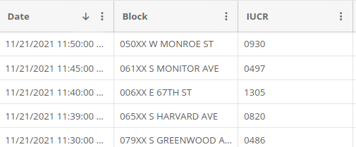
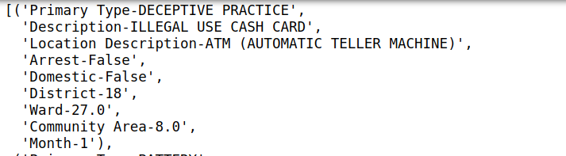
Association Rule Mining - Preprocessing
Preprocessing methods:
Drop redundant or unuseful columns
Add new column
Convert the record data to transaction data

Slide 6
Association Rule Mining - Algorithms used
Apriori algorithm
Efficient Apriori
FP Growth
Concepts:
Support
Confidence
Lift

Slide 7
Association Rule Mining - 2021 data analysis
Support | Confidence | Lift | Number of rules generated | Time taken
0.05 | 0.9 | 1 | 85 | 16s
0.05 | 0.8 | 1 | 110 | 14s
0.10 | 0.8 | 1 | 18 | 2s
0.10 | 0.9 | 1 | 11 | 2s
0.20 | 0.9 | 1 | 1 | 50ms
0.5 | 0.9 | 1 | 0 | 34ms

Slide 8
Association Rule Mining - Algorithm Runtime Comparison
 | Apriori | Efficient Apriori | FP Growth
Support | 0.05 | 0.05 | 0.05
Confidence | 0.9 | 0.9 | 0.9
Lift | 1 | 1 | 1
Time taken | 16s | 0.84s | 1.8s

Slide 9
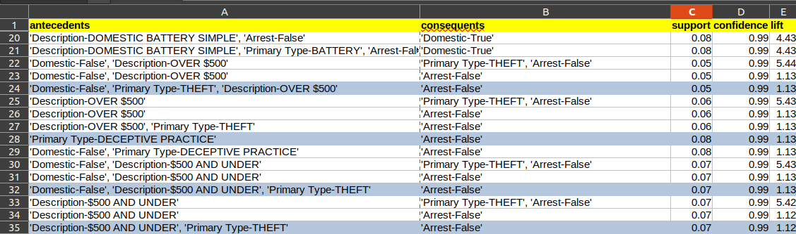
Association Rule Mining - Itemset Generation (2021 data)
Min_support = 0.05, min_confidence = 0.9, min_lift = 1

Slide 10
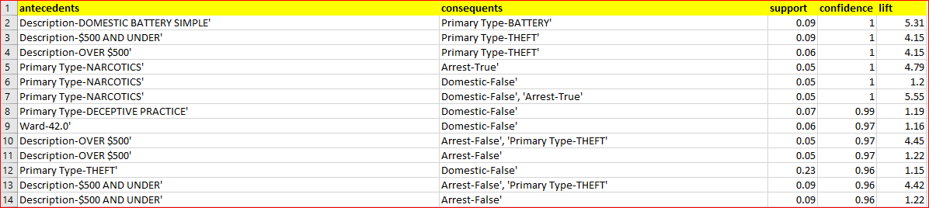
Association Rule Mining - Itemset Generation (Pre-Covid)
Min_support = 0.05, min_confidence = 0.5, min_lift = 1

Slide 11
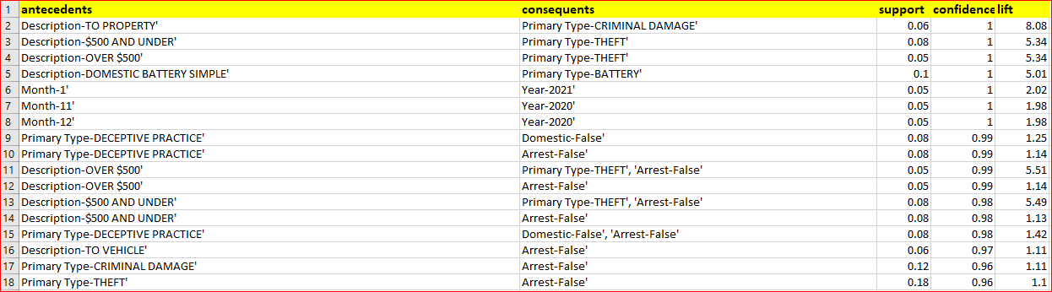
Association Rule Mining - Itemset Generation (Post Covid)
Min_support = 0.05, min_confidence = 0.5, min_lift = 1

Slide 12
Association Rule Mining - 2021 data conclusion
In districts 4 and 8, no arrests have been made for more than 90% of the crimes.
The months of August and September contribute to 20% of the annual crime. And yet no arrests were made for more than 90% of the cases.
In following crimes, arrests rates were very low:
Theft over $500 - 1%
Theft under $500 - 1%
Deceptive practice - 1%
Criminal Damage to vehicle - 2%
Simple Assault - 6%
Crimes committed at residences, apartments - 6%, contributes to 25% of the crimes.

Slide 13
Association Rule Mining - Pre/Post Covid data conclusion
Pre-Covid, the arrest rate for the case of Narcotics was 100% whereas no cases were recorded post covid with the same rate of confidence.
Post-Covid thefts increased about 40%
Pre-Covid, the months of August and September resulted in 15% of the crime whereas Post-Covid it increased to 20%, and yet the arrest was only about 1%
In the following crimes, arrests rates are very low:
Theft over $500 - 1%
Theft under $500 - 1%
Deceptive practice - 1%
Criminal Damage to vehicle - 2%

Slide 14
Clustering - Data Preprocessing
Dropping unnecessary columns like Beat, Case Number, FBI Code, Location co-ordinates, etc.
Splitting the date type data into date and time, and the time data into seconds, hours and months
We then normalized all these values to bring them to a scale of 0 to 1.

Slide 15
Clustering - Techniques used
K-Means clustering
K-Modes clustering
Hierarchical Agglomerative Clustering

Slide 16
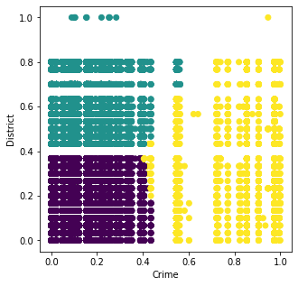
K-Means
We implemented k-means for multiple combinations of dimensions
The most insightful one was for IUCR and District
Main finding - crimes such as IUCR Codes 5131 (other offence - violent offender), 4387 (Violation of Order of Protection), 3731 (Obstructing Identification) etc occur much less frequently than others

Slide 17
K-Modes
Extension of K-Means algorithm - works on categorical data, uses Hamming distance as the distance measure
Performed clustering on Types of Crimes and Districts; and Crime types and Arrests
The results helped validate results of kmeans clustering - most crimes occurring in most districts, led to new insights
District 7 is more prone to Crimes like 'Battery', 'Deceptive practice', 'Weapons violation', ‘Burglary'
Very few arrests were made for crimes such as 'Assault', 'Criminal Damage', 'Motor Vehicle Theft' out of all 31 unique crime types

Slide 18
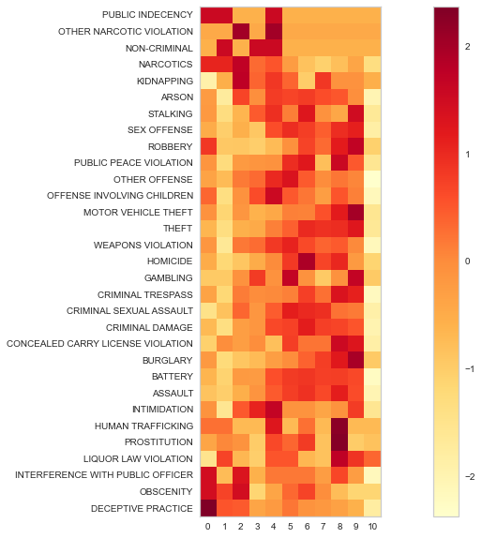
Hierarchical Agglomerative Clustering (HAC)
HAC was used to get much deeper and granular insights about the distribution of crime across various dimensions
Months and Crime types Findings -
i) Deceptive Practice and Public Indecency occurred more frequently in January and February
ii) Assault, Burglary, Homicide had the highest occurrences between June and October
iii) Relatively fewer crimes have occurred in March and October

Slide 19
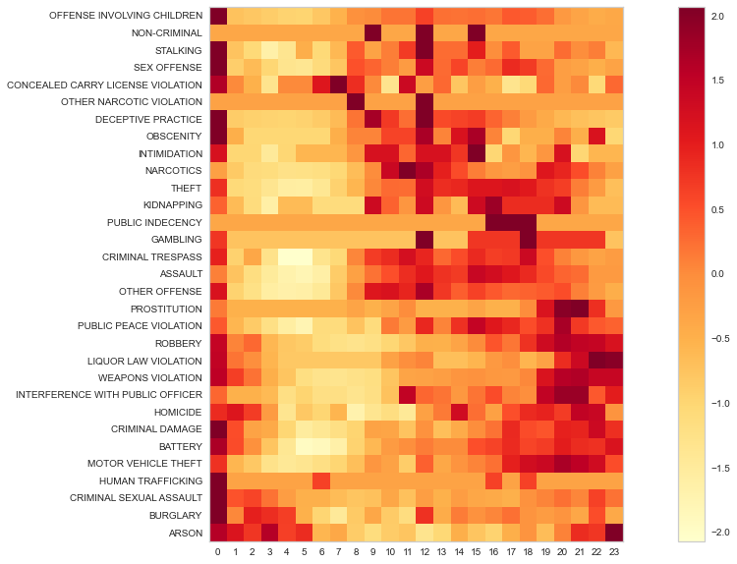
Hierarchical Agglomerative Clustering (HAC)
Hour and crime types findings -
i) Arson, liquor law violation, crimes involving children, obscenity, homicides and sex offences occurred the most frequently between 10 pm and 1 am
ii) Public indecency and other offences occurred more frequently in the afternoon
iii) 6-8 am seem to be safer hours for the city

Slide 20
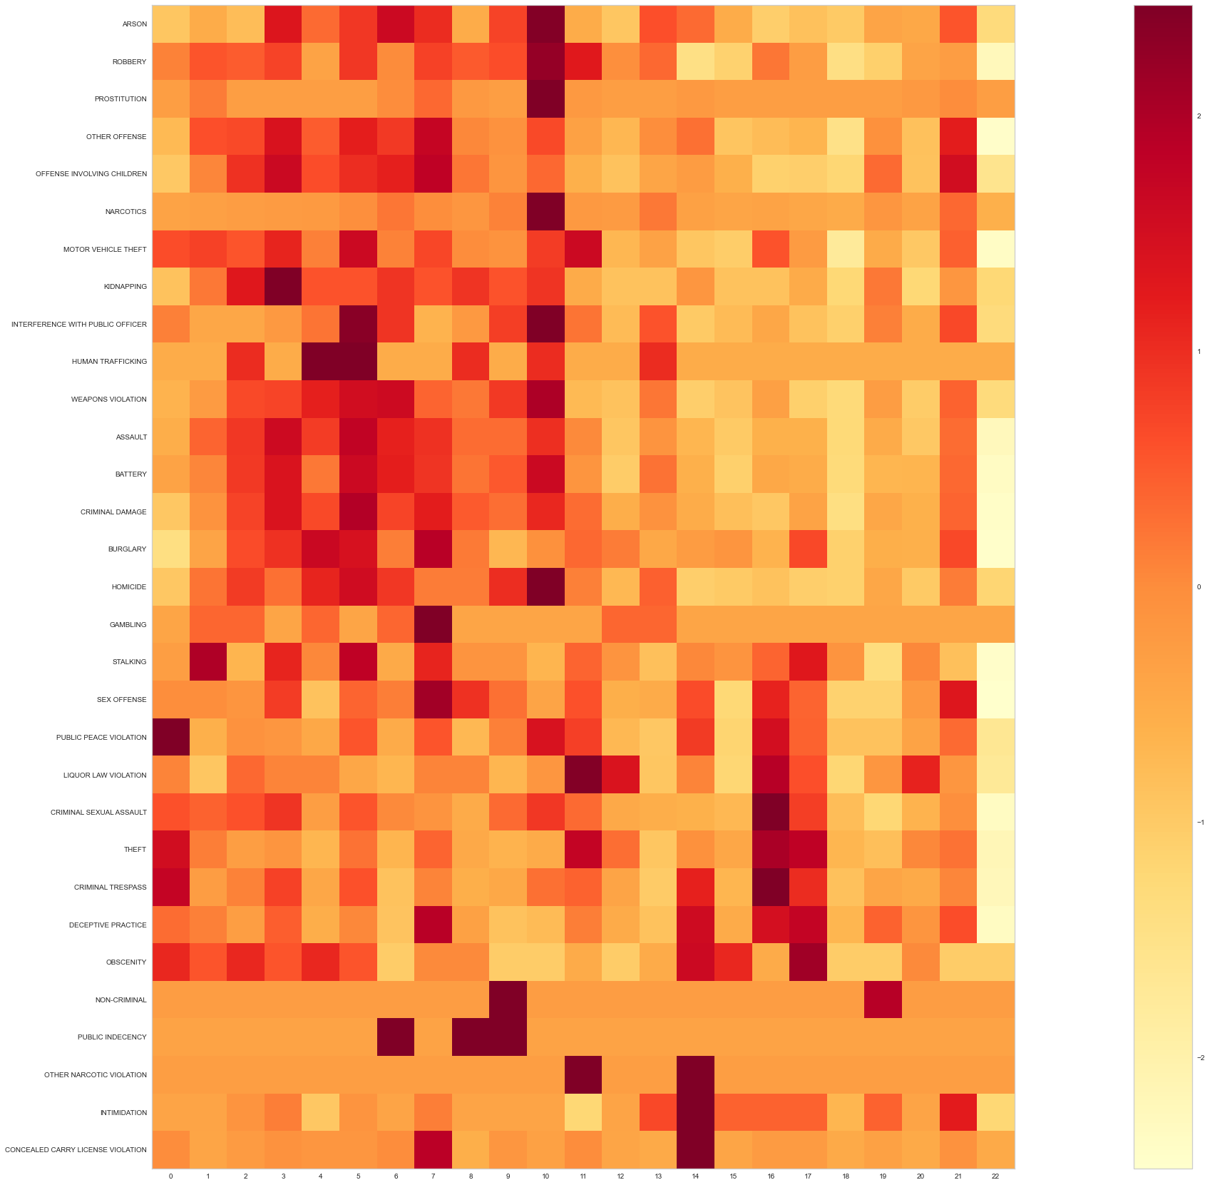
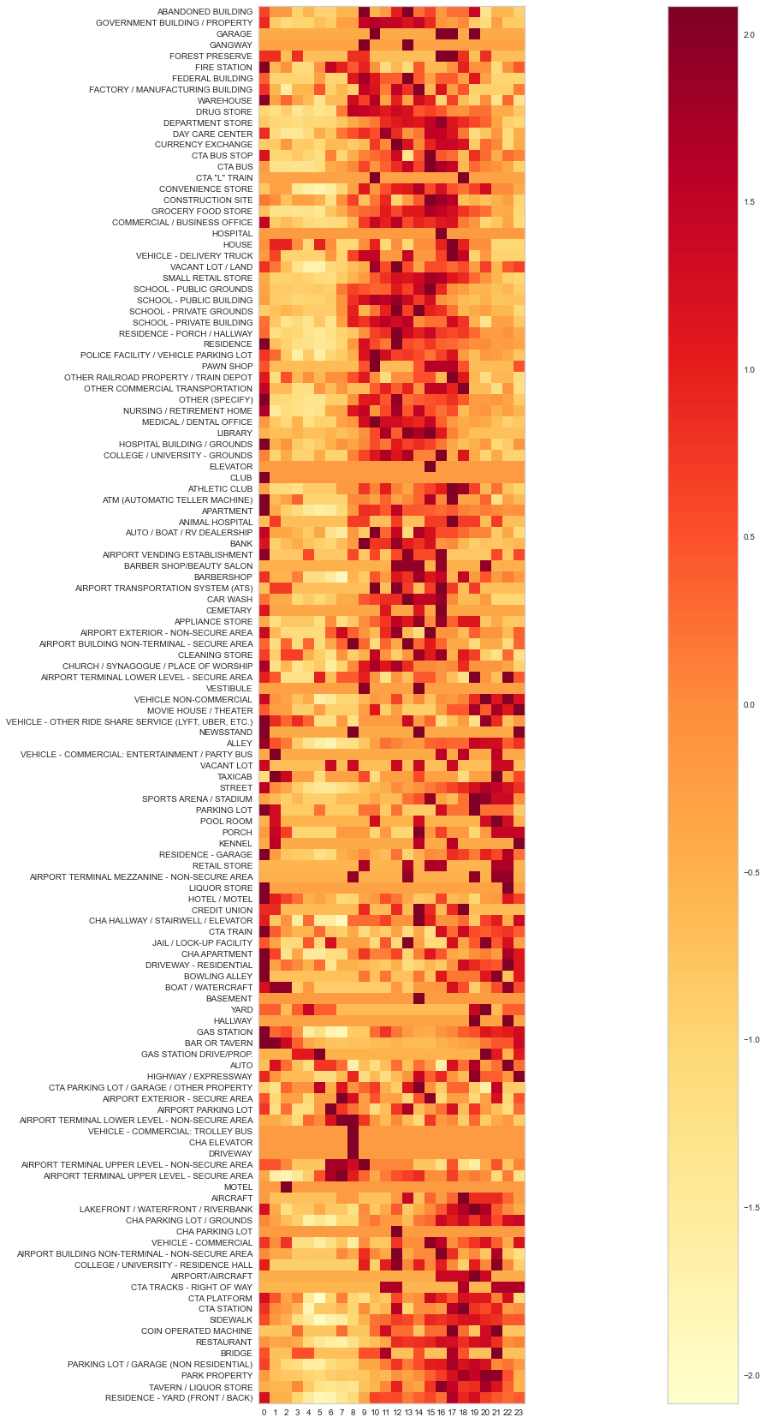
District and Crime types
Hour and Location of Crime

Slide 21
Thank you

